Slide 1
A Comprehensive Measure Of Well Being
SlideMake.com

Slide 2

Introduction to Well-Being
Well-being encompasses the overall quality of life and personal fulfillment.
Traditional measures often focus on economic indicators like GDP, which may not capture holistic well-being.
A comprehensive measure aims to include multiple dimensions that influence human happiness and functioning.
Notes:
Image source: https://techwiser.com

Slide 3
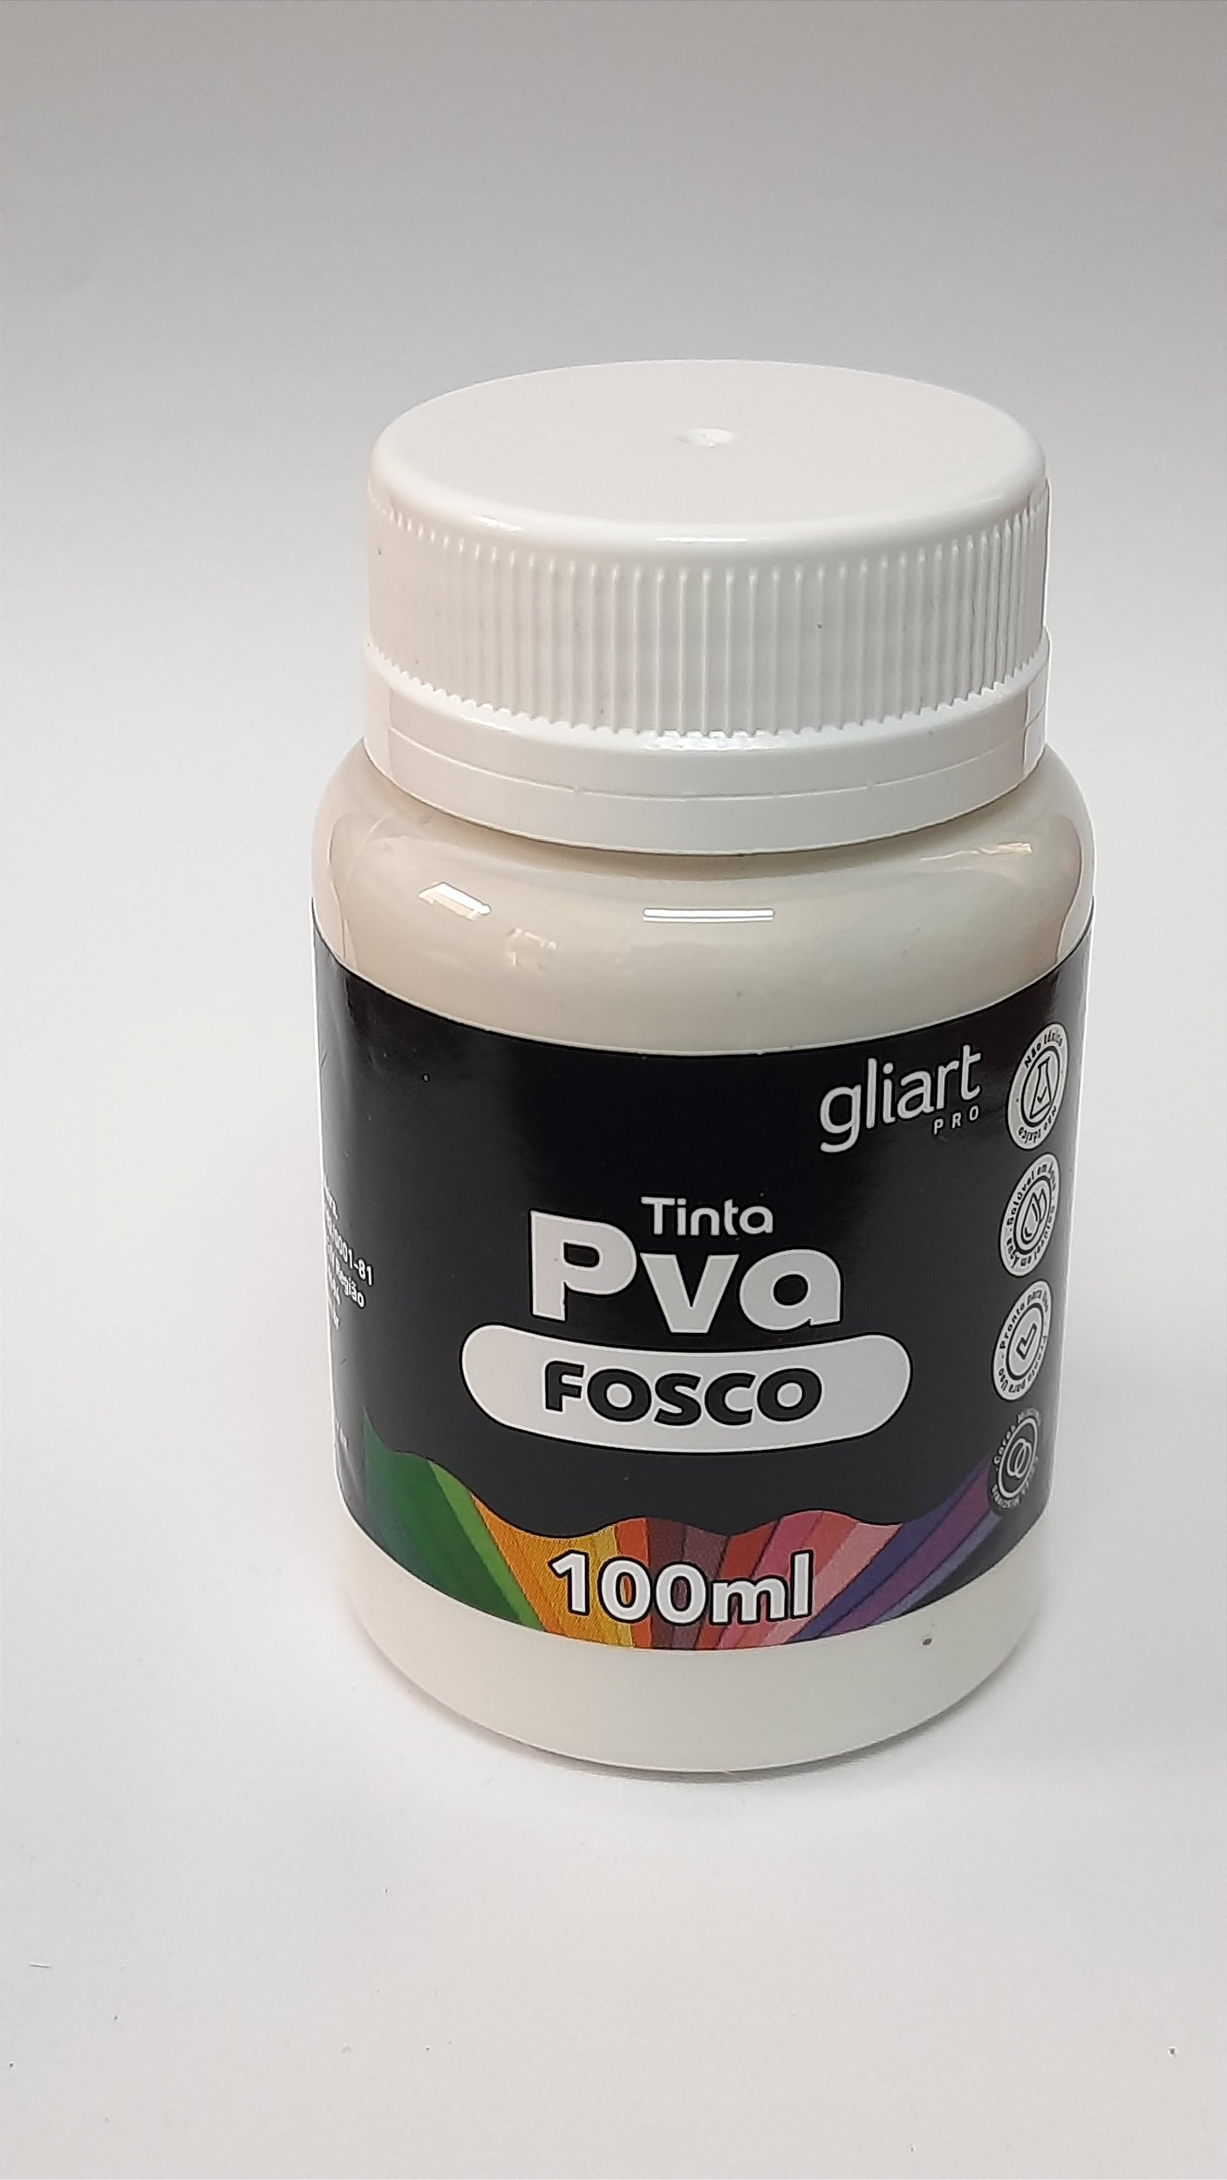
Limitations of Traditional Economic Indicators
GDP and similar metrics primarily assess economic activity, ignoring social and psychological factors.
Economic growth does not necessarily correlate with improvements in health, education, or life satisfaction.
Relying solely on economic indicators can lead to misinformed policy decisions that overlook well-being.
Notes:
Image source: https://cdn.awsli.com.br

Slide 4
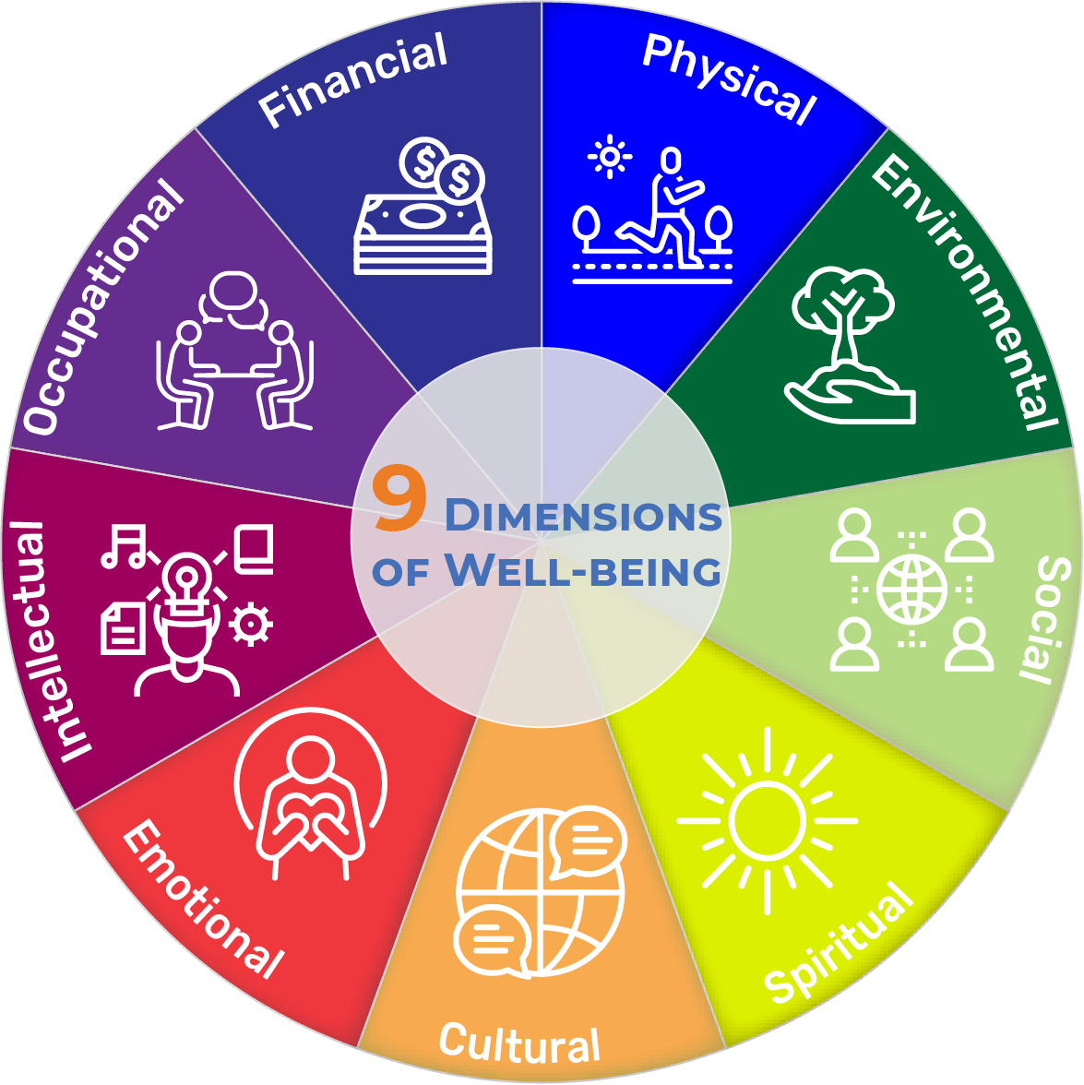
Dimensions of Well-Being
Well-being includes physical health, mental health, social connections, and environmental quality.
It also encompasses subjective aspects like happiness, life satisfaction, and sense of purpose.
Recognizing multiple dimensions helps create a more accurate picture of quality of life.
Notes:
Image source: https://images.squarespace-cdn.com

Slide 5
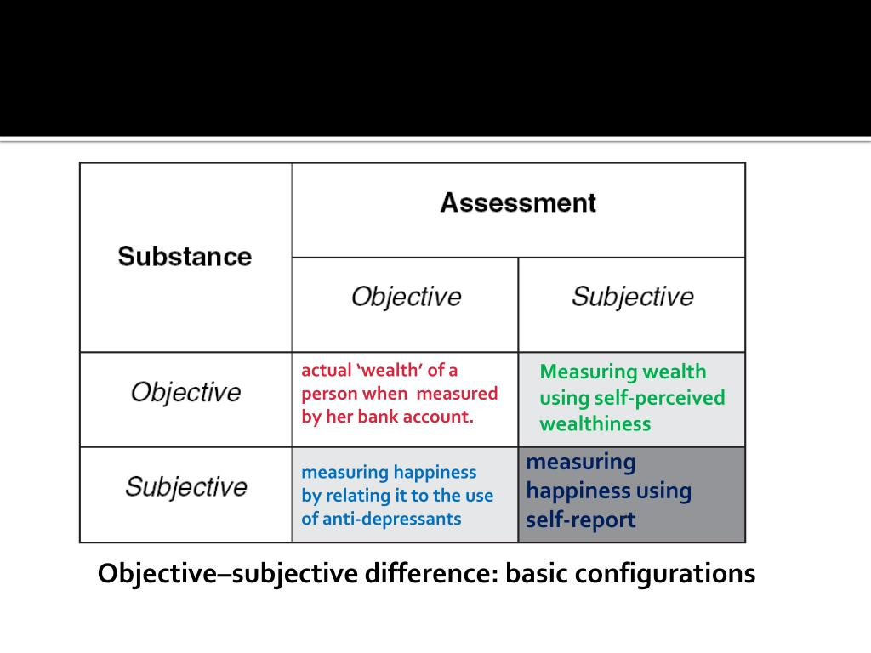
Objective vs. Subjective Measures
Objective measures include income, employment status, health metrics, and education levels.
Subjective measures capture personal perceptions of happiness, stress, and overall life satisfaction.
Combining both types of measures provides a more balanced and comprehensive assessment.
Notes:
Image source: https://image1.slideserve.com

Slide 6
Existing Frameworks and Indices
The Human Development Index (HDI) includes health, education, and income to measure development.
The World Happiness Report incorporates subjective well-being and social support indicators.
The OECD’s Better Life Index allows comparison across countries based on multiple well-being components.
Notes:
Image source: https://www.act.gov.au

Slide 7

Developing a Comprehensive Well-Being Measure
It involves selecting relevant indicators across physical, mental, social, and environmental domains.
Data collection should be consistent, reliable, and culturally sensitive.
Weighting of different components can be tailored to reflect societal priorities and values.
Notes:
Image source: https://www.slidemake.com

Slide 8
Challenges in Measurement
Subjectivity can introduce bias and variability in self-reported data.
Cultural differences may influence perceptions of well-being and happiness.
Ensuring comparability across contexts requires careful methodological design.
Notes:
Image source: https://unece.org

Slide 9
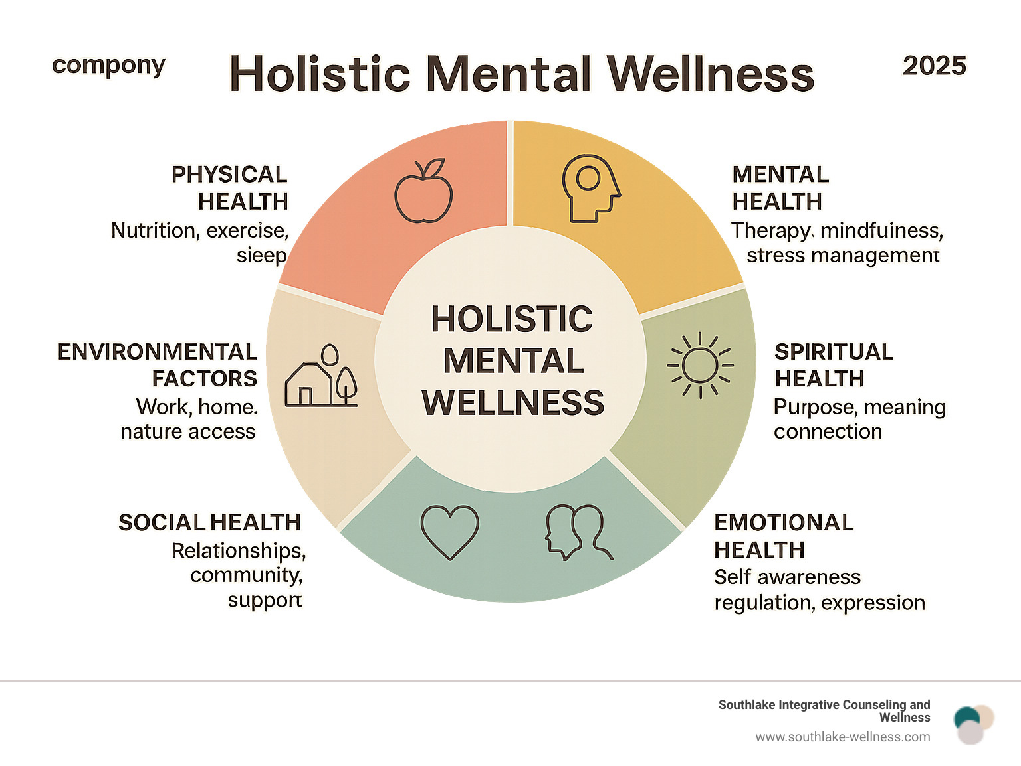
Benefits of a Holistic Approach
A comprehensive measure can inform more effective and inclusive policy decisions.
It highlights areas needing improvement beyond economic growth, such as mental health or social cohesion.
Such measures can promote sustainable development focused on human flourishing.
Notes:
Image source: https://cdn.prod.website-files.com

Slide 10
Future Directions and Innovations
Advances in technology enable real-time data collection and analysis of well-being indicators.
Incorporating qualitative data can deepen understanding of individual and community experiences.
Collaborative efforts among governments, researchers, and communities are essential for refining measures.
Notes:
Image source: https://www.slidemake.com

Slide 11
Conclusion
A comprehensive measure of well-being provides a more complete understanding of human quality of life.
Integrating multiple indicators allows for targeted interventions to improve overall well-being.
Moving beyond traditional metrics is crucial for fostering healthier, happier, and more resilient societies.
Notes:
Image source: https://unece.org

